Slide 1
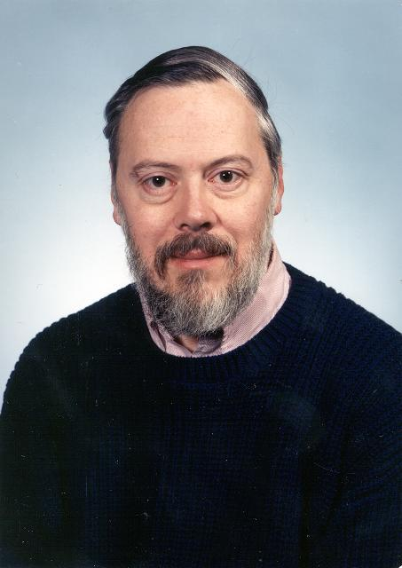
Introduction to Programming in C
Prof. Darrell Long
CSE 13S
Dennis Ritchie

Slide 2
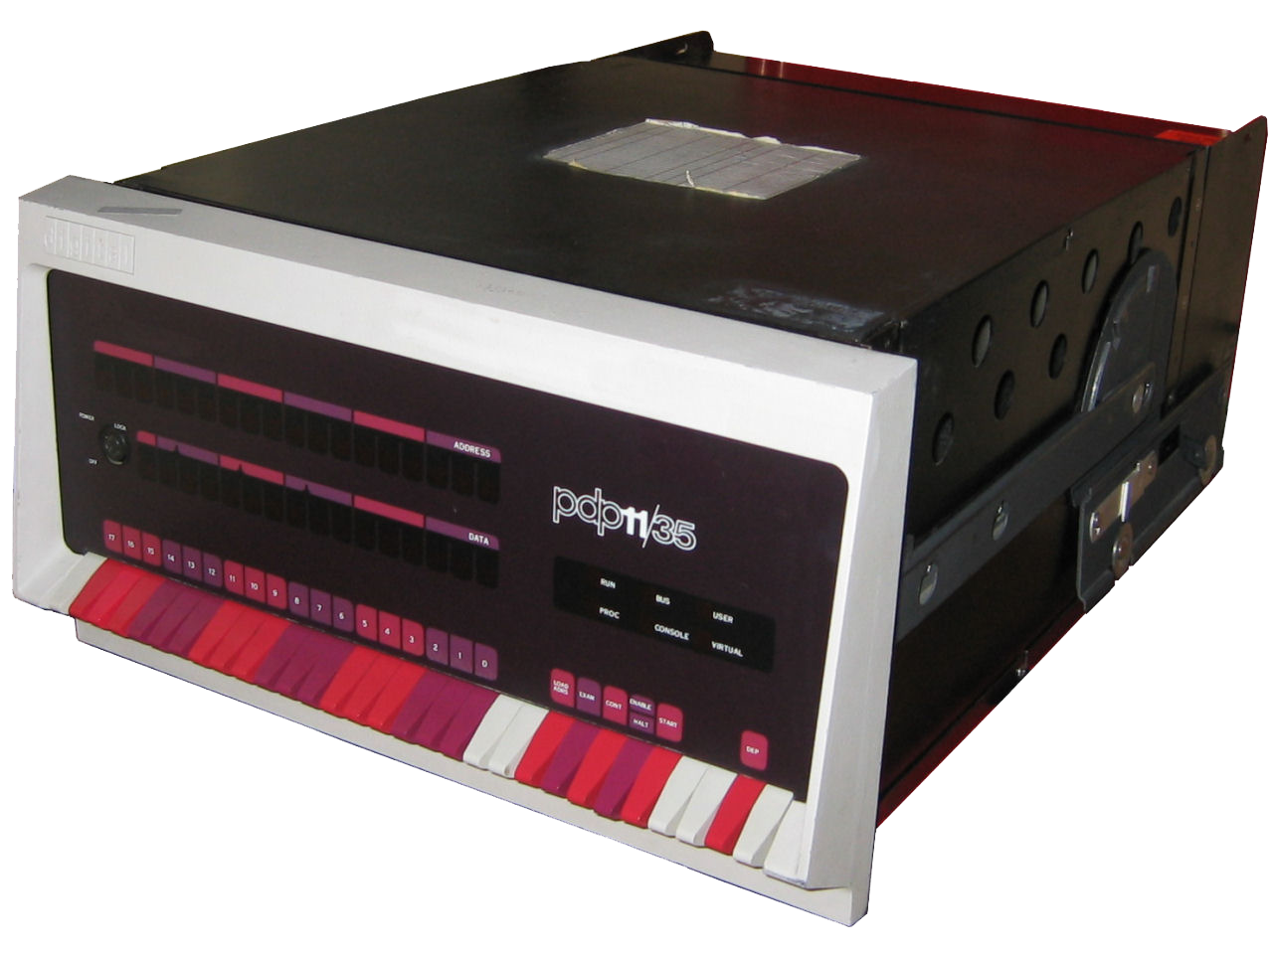
Where did C come from?
Year | C Standard
1972 | Birth
1978 | K&R C
1989 | ANSI C
1999 | C99
2011 | C11
2018 | C18
Derived from B, written by Ken Thompson
Influenced by
CPL and BCPL languages
PDP-11 processor

Slide 3
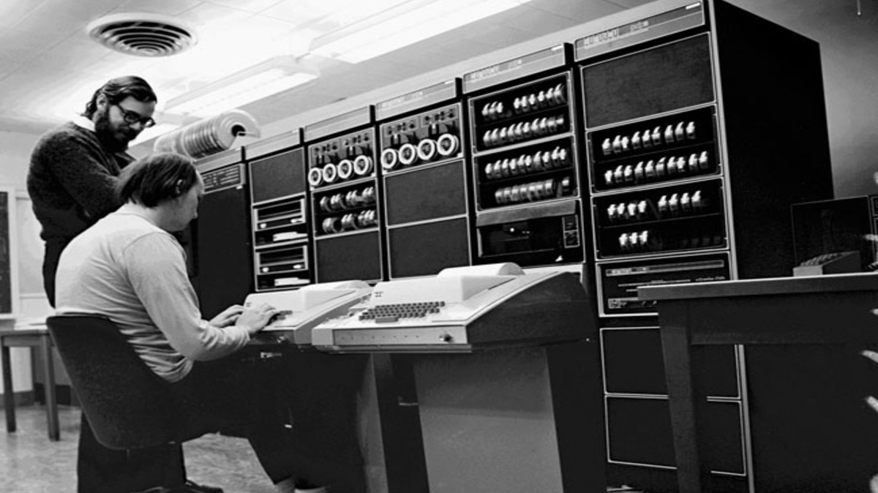

Slide 4
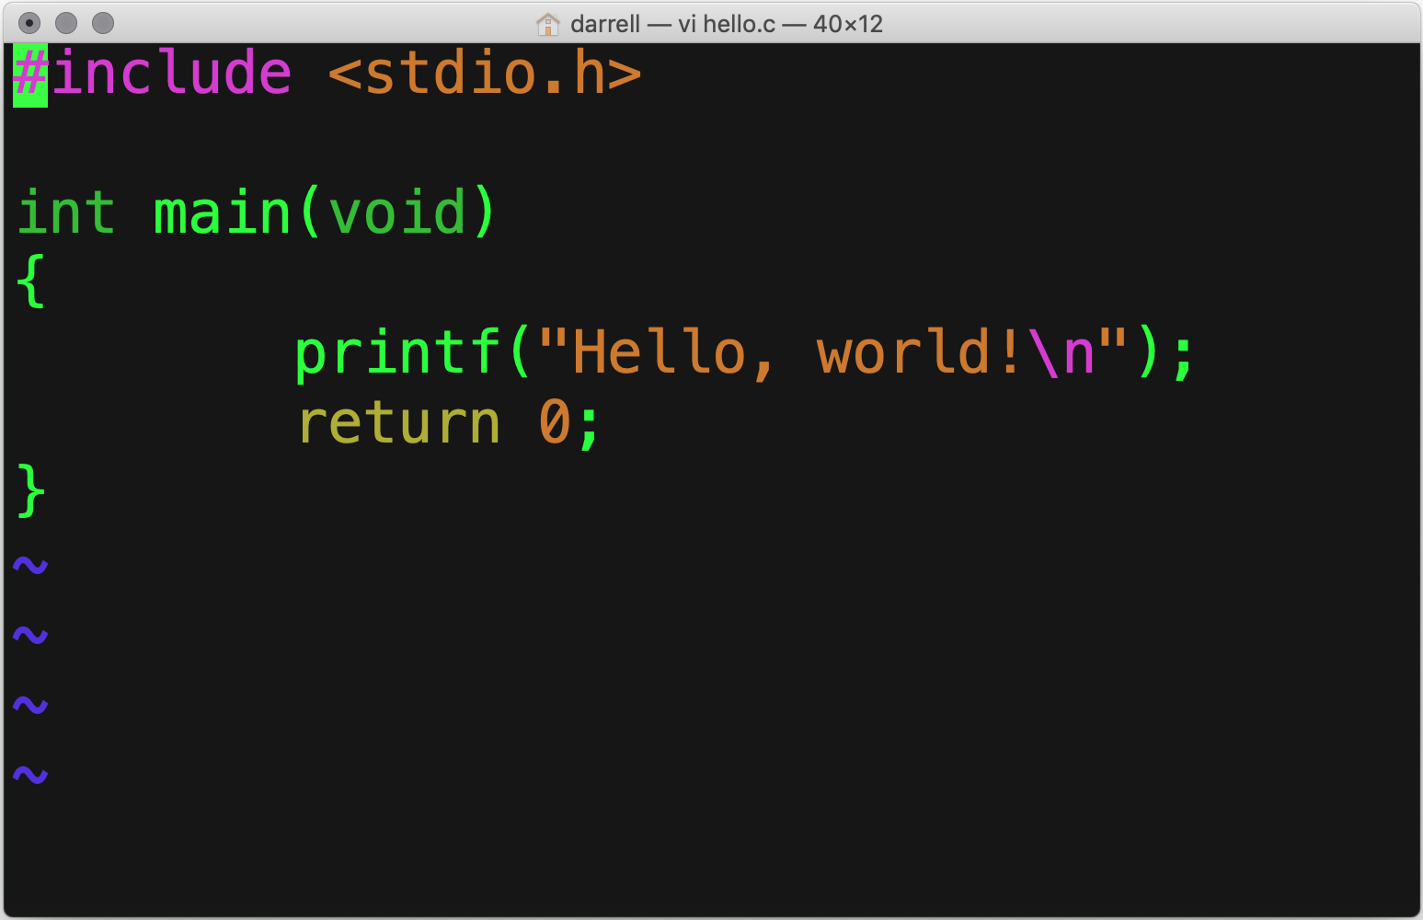
Hello, World!
Standard I/O package
Print
0 means success

Slide 5
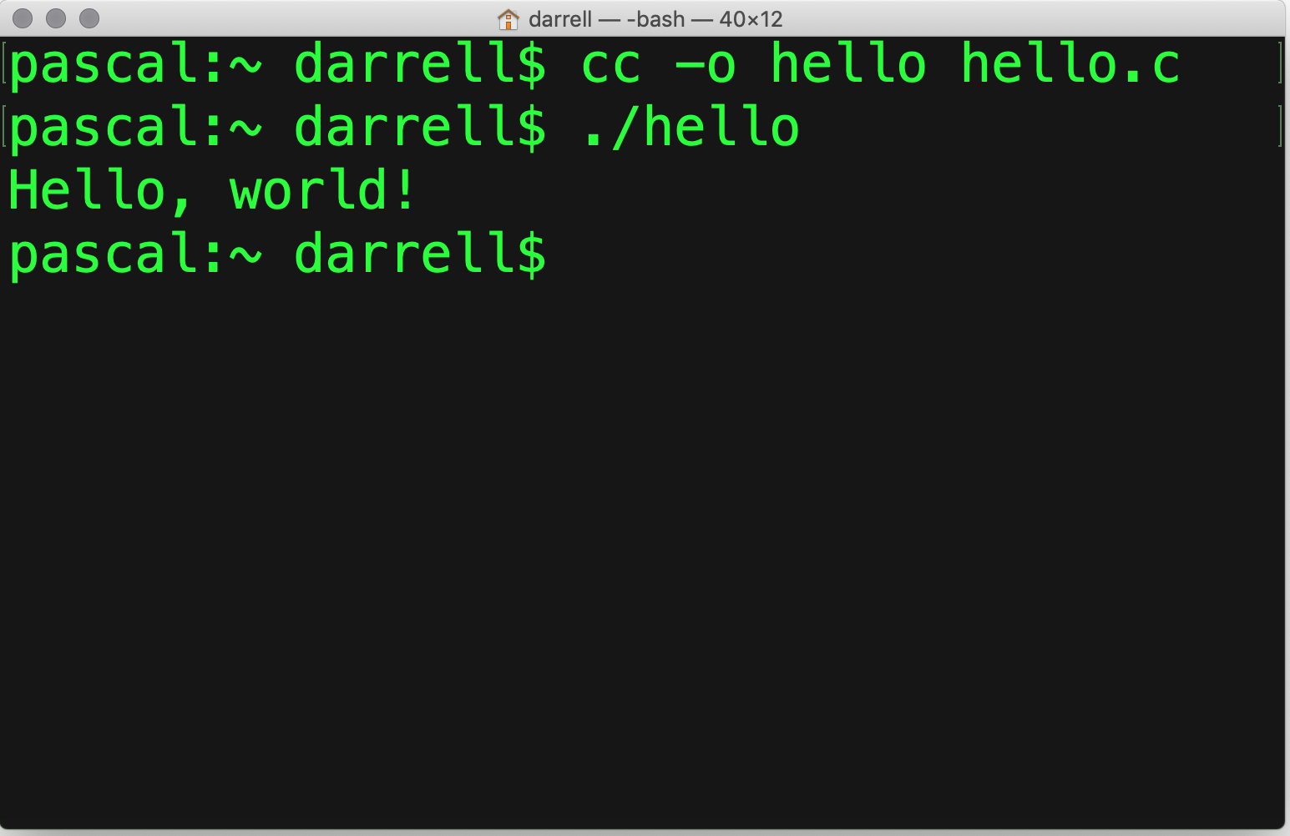
Compile and run!
Compile
Run

Slide 6
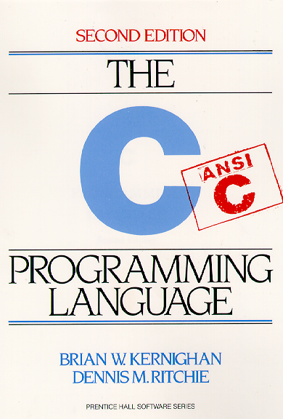
You must read this book!
Yes, it presents a dated version of C:
ANSI C versus C11
Most people still do not use the features of C11 daily.
It is simple,
Clear,
Short, and
A classic.
All good things!
It is how all of your professors learned C.

Slide 7
Temperatures
Kelvin is the scale for science:
0 K ➠ All nuclear motion ceases (absolute zero)
℃ = K – 273.15
℉ = ℃ × 9 ÷ 5 + 32
Scale | 0 | 58 | 100
K | Dead | Dead | Dead
℃ | Snow | Hottest on Earth | Water Boils
℉ | Minnesota | Santa Cruz | Tucson

Slide 8
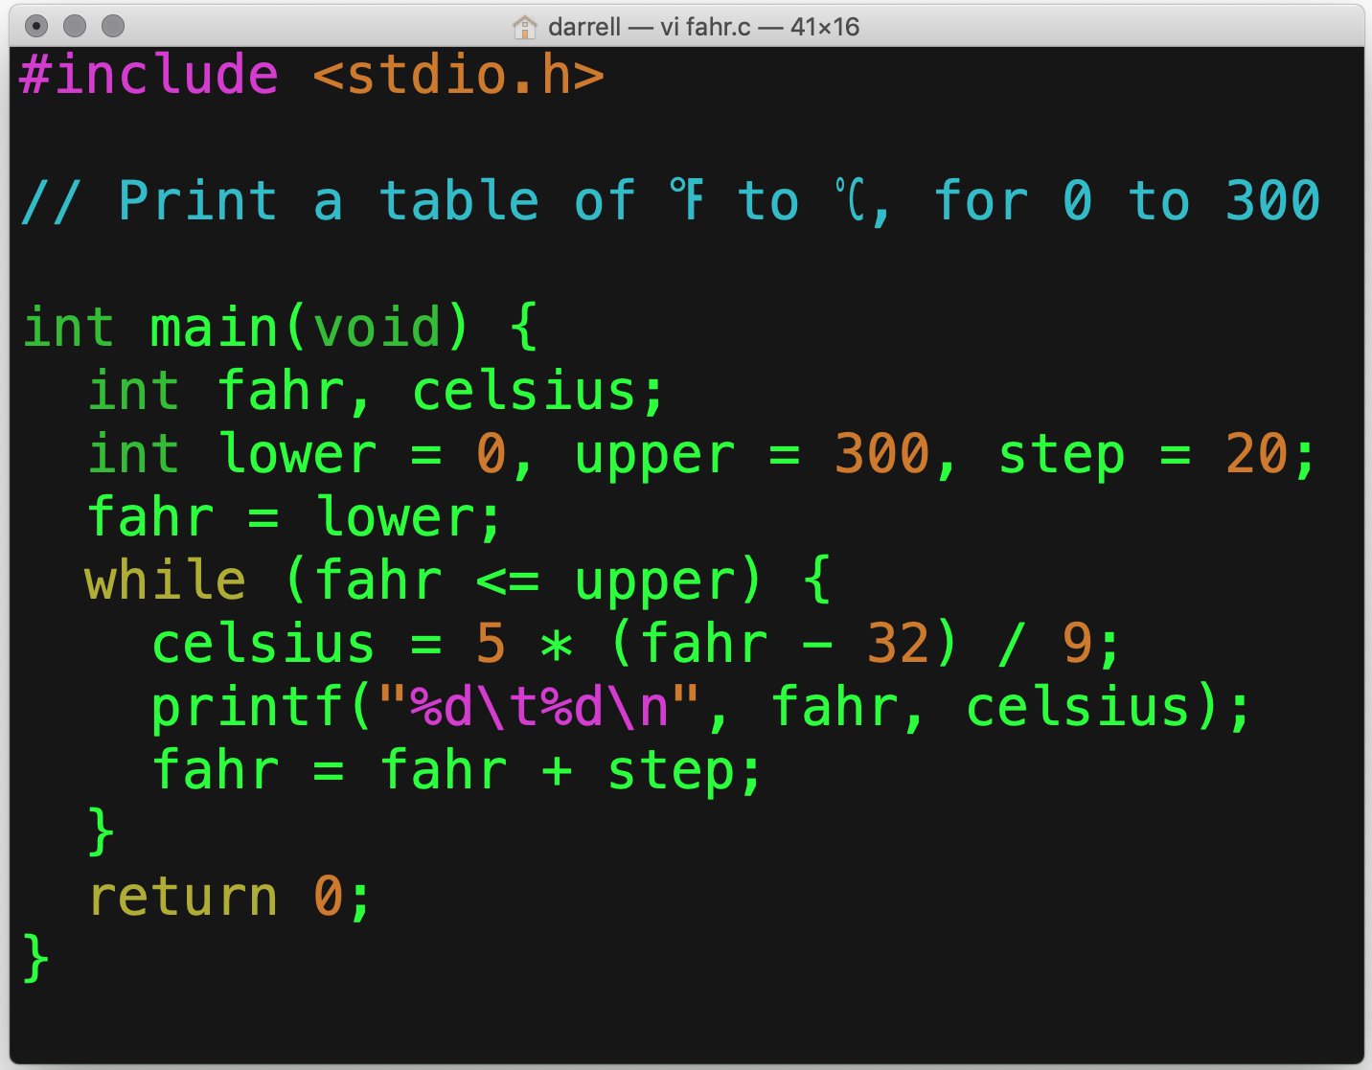
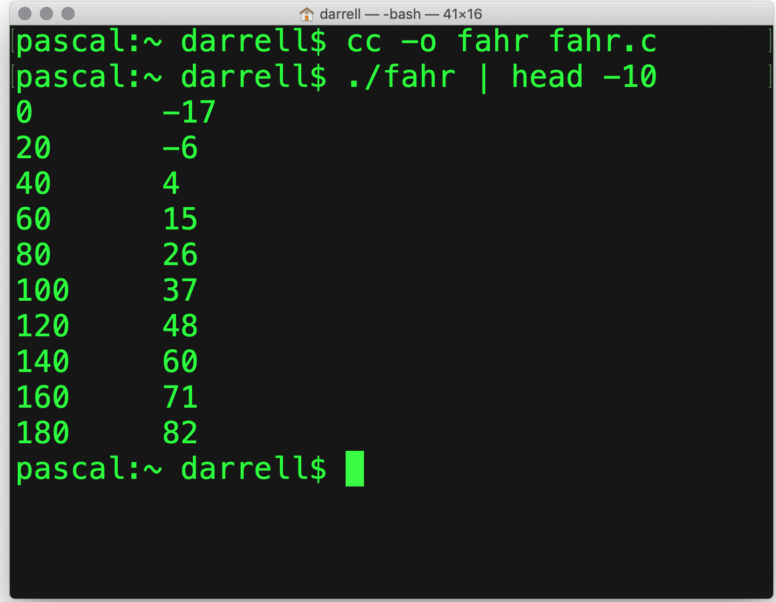
First Attempt
Should we be concerned?

Slide 9
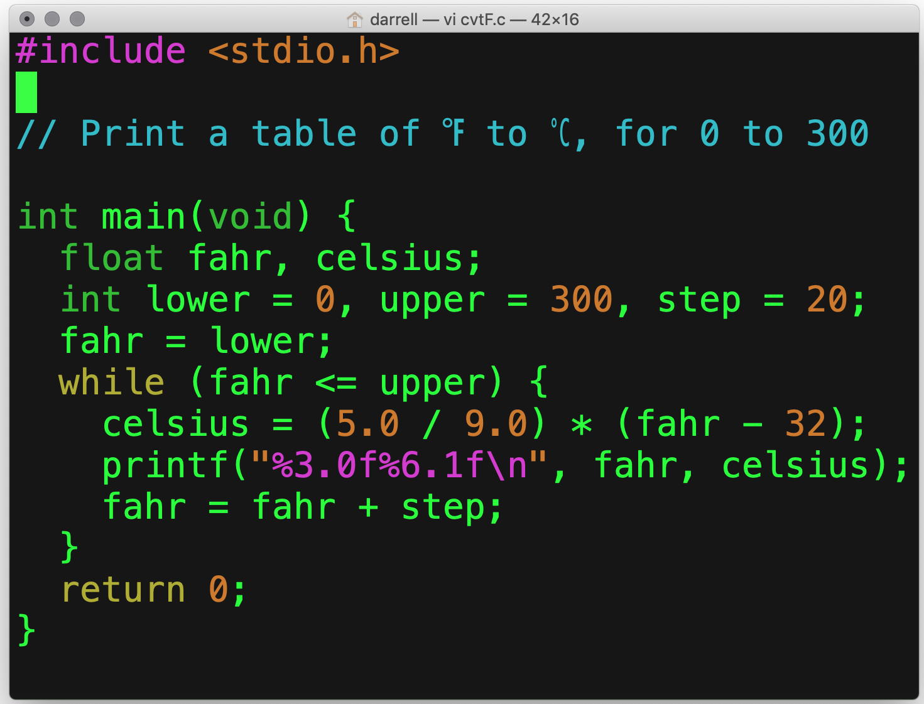
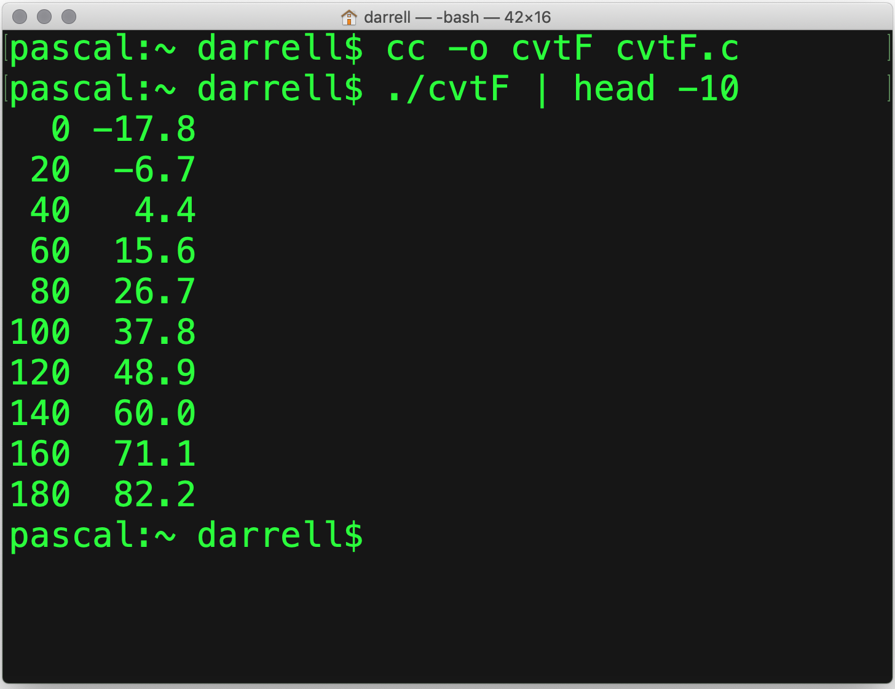
Second Attempt

Slide 10
Comparing Results
Integer arithmetic truncates!

Slide 11
int main(void)
There is exactly one main program.
It’s really just a function with a special name.
It returns an int as its status value.
In this case, it takes no arguments.

Slide 12
{ … }
C is a “curly brace” language
Many were influenced by C.
{} are used to group statements.
Use them even for single statements.
{} is called a block.
A block introduces a local scope.
We will discuss this later.

Slide 13
while ()
while () is the simplest loop.
It is called a top-test loop.
More on that later.
It executes while the Boolean statement inside the () is true.
Always use {} with while, even for a single statement.

Slide 14
printf()
printf() is just a function in the standard I/O library.
It’s not magic, you could write it too!
“%6.1f” is called a format string.
It says: there is a floating point number, 6 characters wide, with one digit after the decimal place.

Slide 15
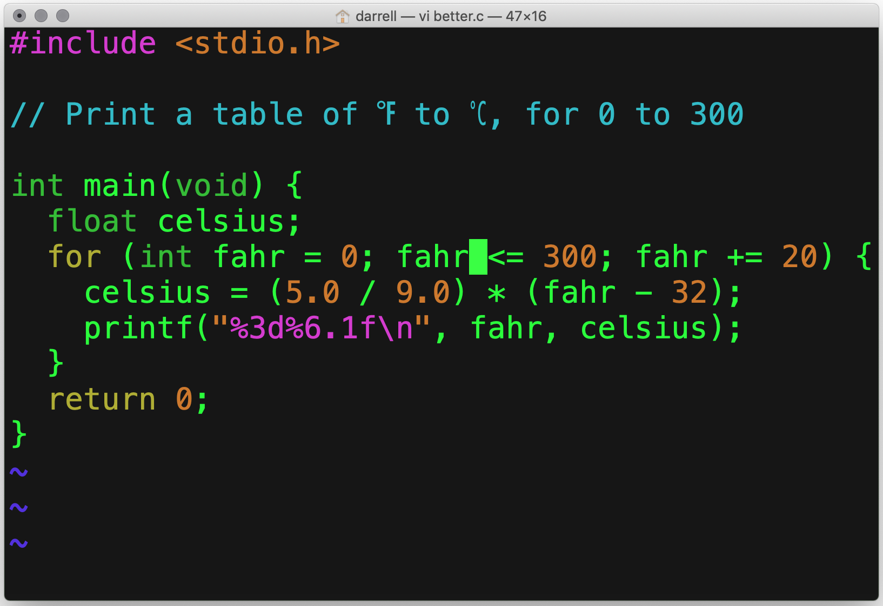
for ()
Why is this better?
Many would say it is easier to understand.
The initialization is explicit.
The test and increment are all visible at the top.
Clarity above all.
Do not try to be clever.
Initialize
Check
Increment
Type Promotion

Slide 16
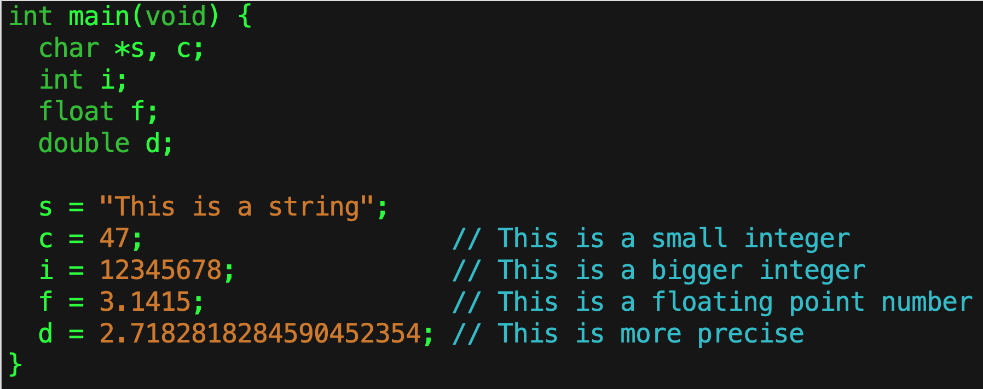
Declaring Variables
In C, you must declare a variable before you can use it.
Declaring it means to specify its type.
For now, we will be concerned with the scalar types:
char, int, and
float, and double.

Slide 17
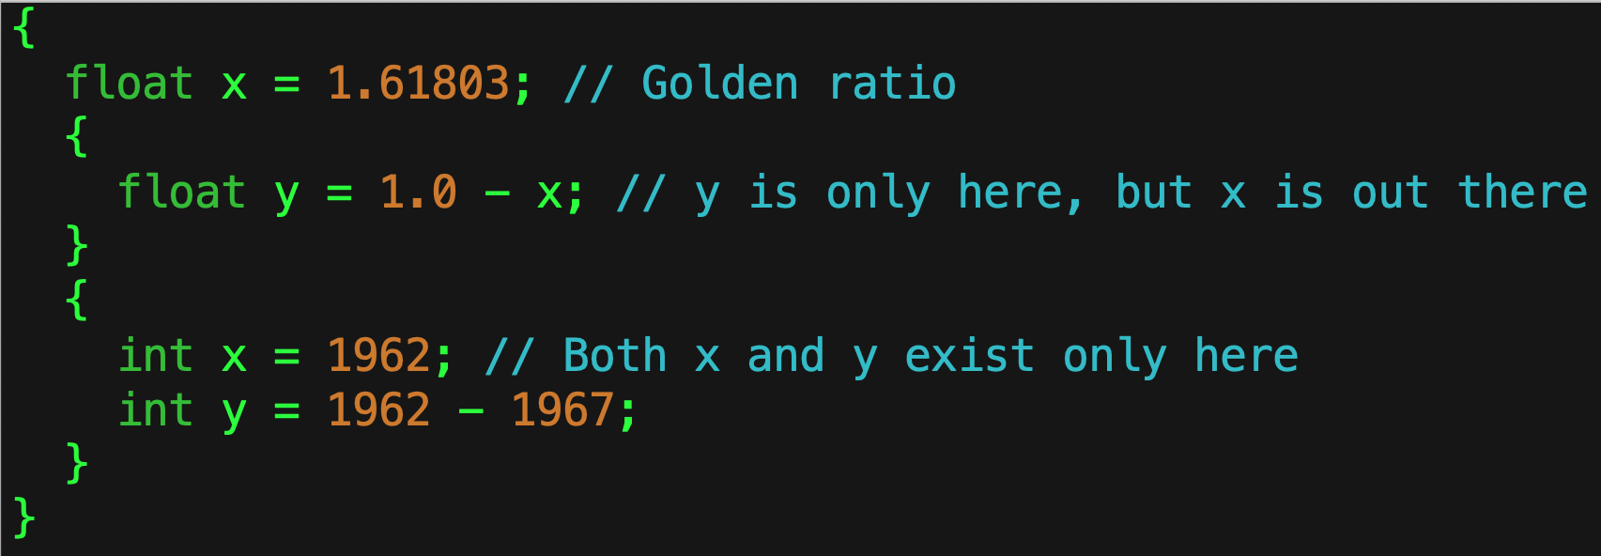
Scope
Each pair of “curly braces” { … } introduce what is called a scope.
The scope of a variable tells us where that variable exists, or is defined.

Slide 18
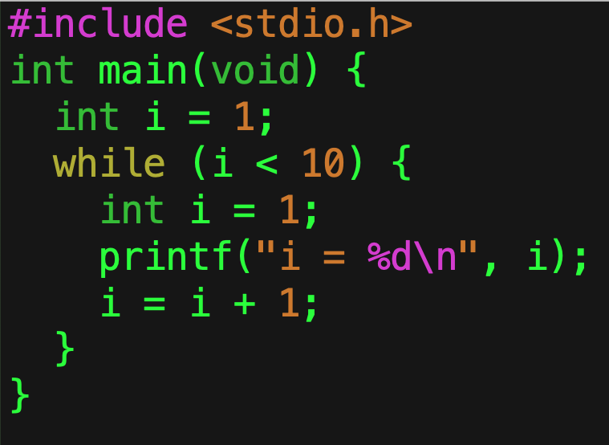
Scoping Rules
When you have a set of { … } you create a new scope.
You can create new local variables in that scope.
Those local variables can have any type.
They can have any legal name.
If they have the same name as a variable in an outer scope, then they hide that variable.

Slide 19
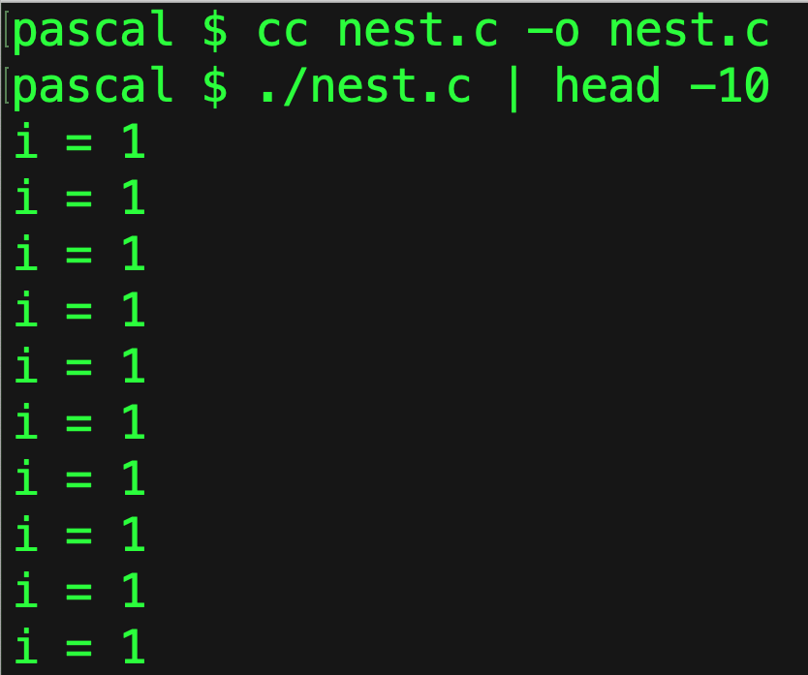
So what happens?
Outer
Inner
The outer i gets hidden by the inner i!
The outer i is always 1.
The inner i is 1, then 2, then back to 1 again.
Why didn’t C warn me?
C always does exactly what you tell it, and what you did was legal.

Slide 20
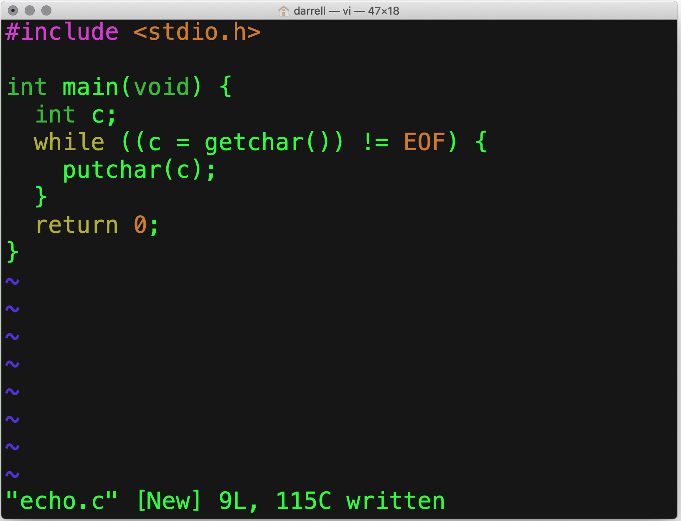
Copy stdin to stdout
Pay attention to this!
Returns int
Read a char
Write a char

Slide 21
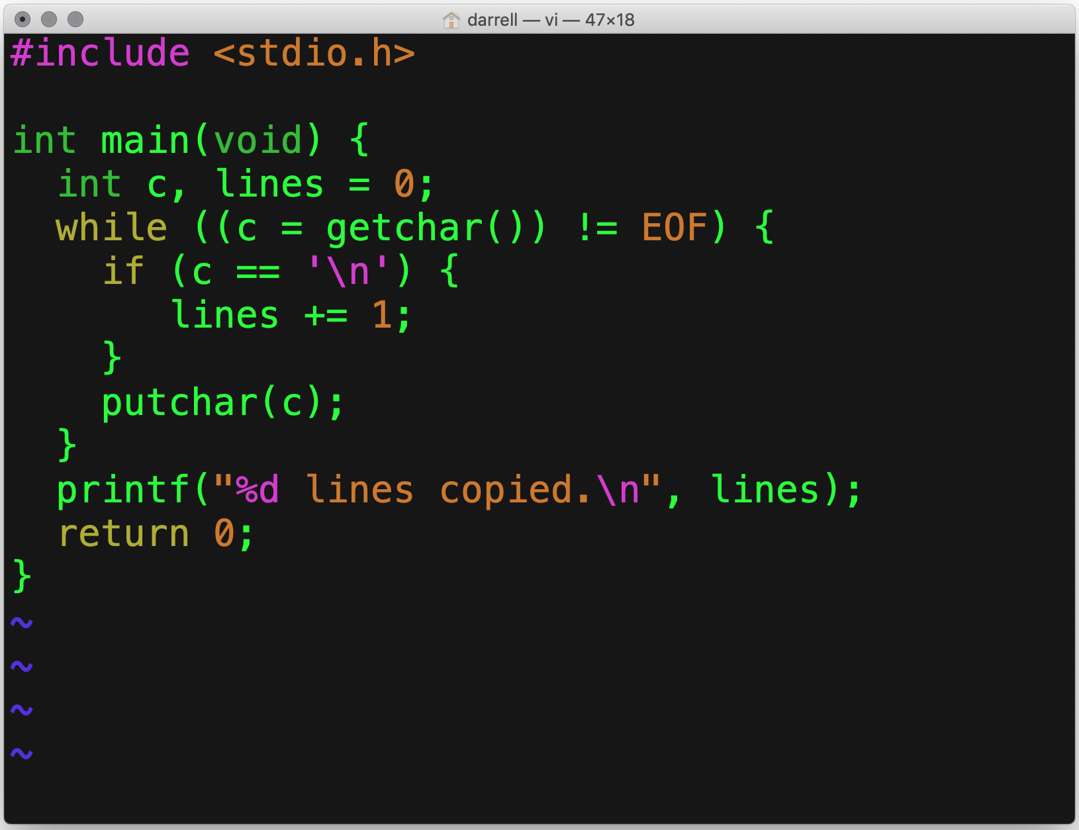
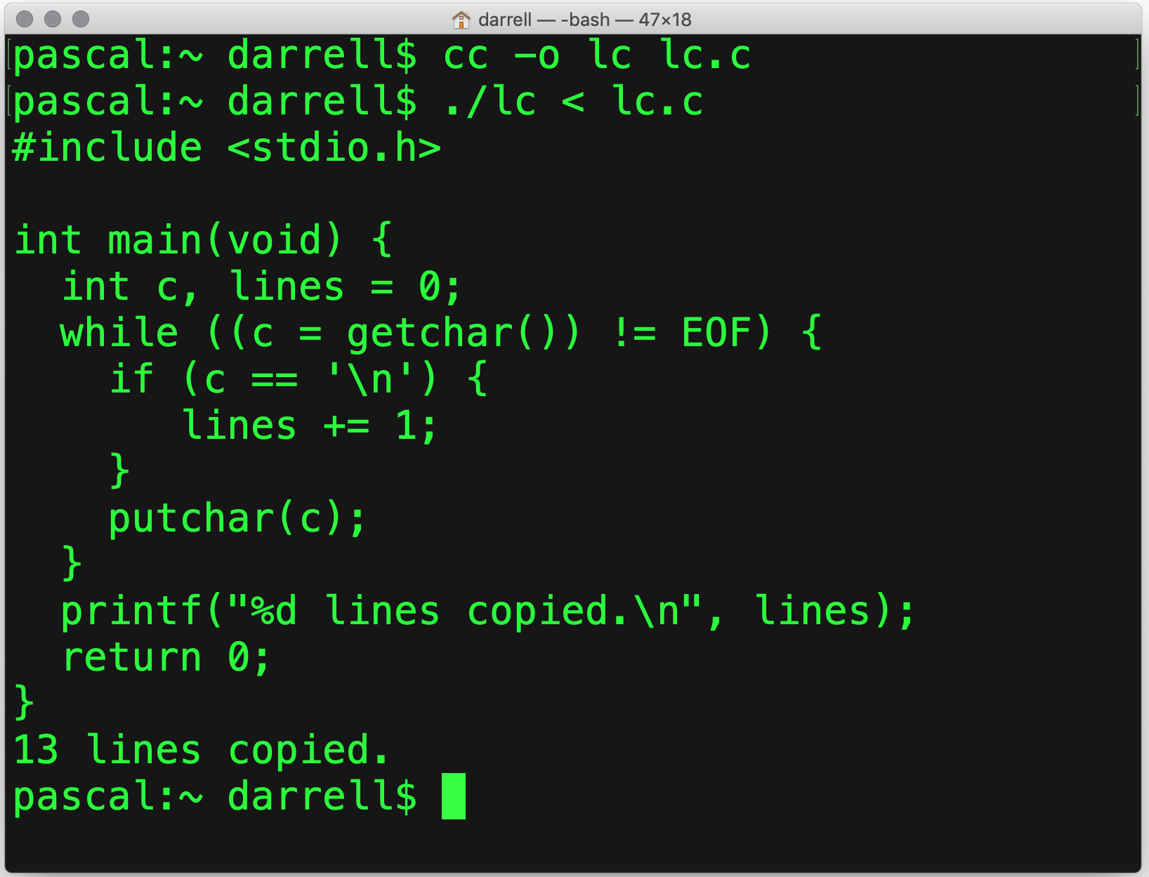
Count Lines
lines = lines + 1

Slide 22
if ()
if executes the next statement if the Boolean expression is true.
Even through {} are not required for a single statement, always use them.
Why?
It avoids errors when adding statements.

Slide 23
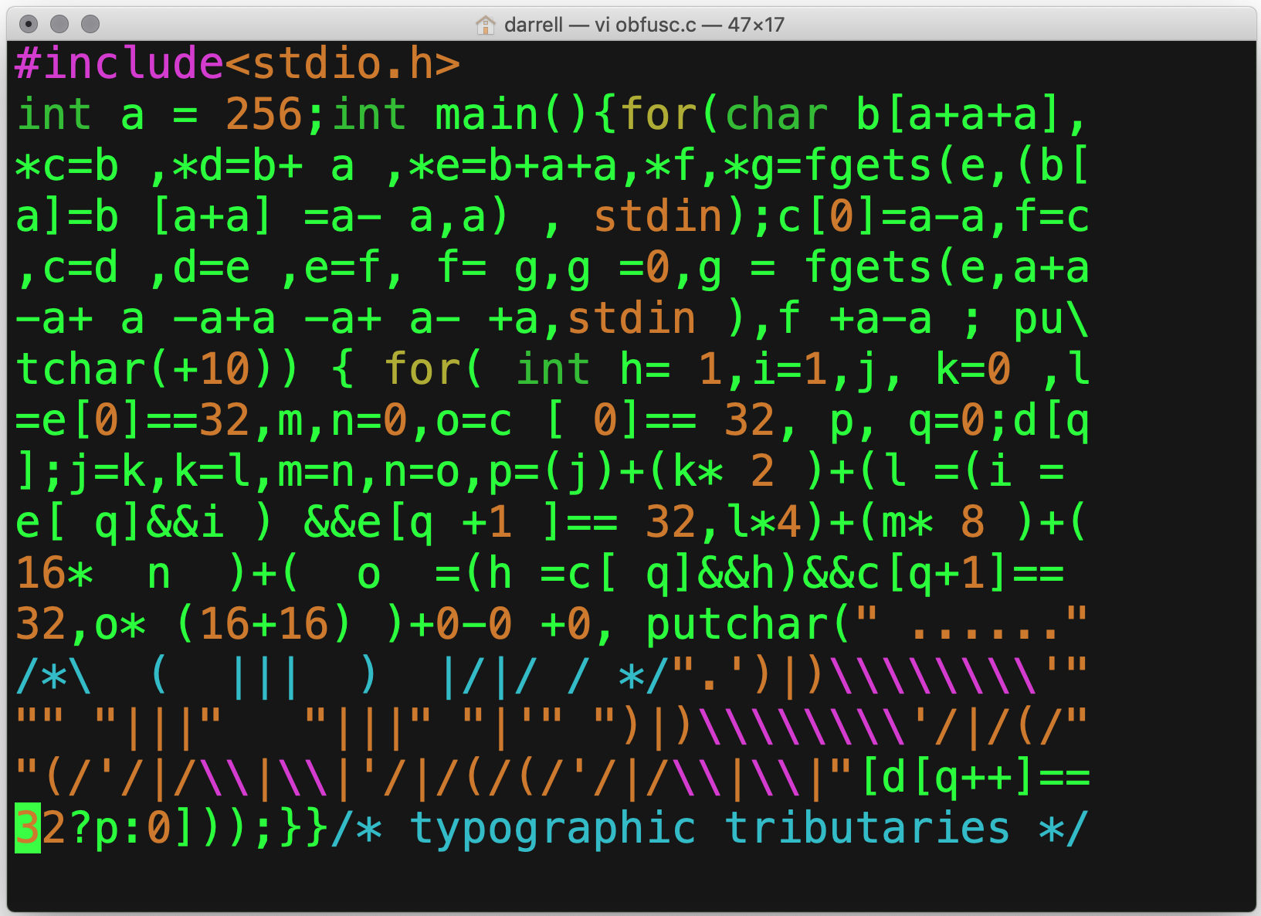
Do not try to be clever…

Slide 24
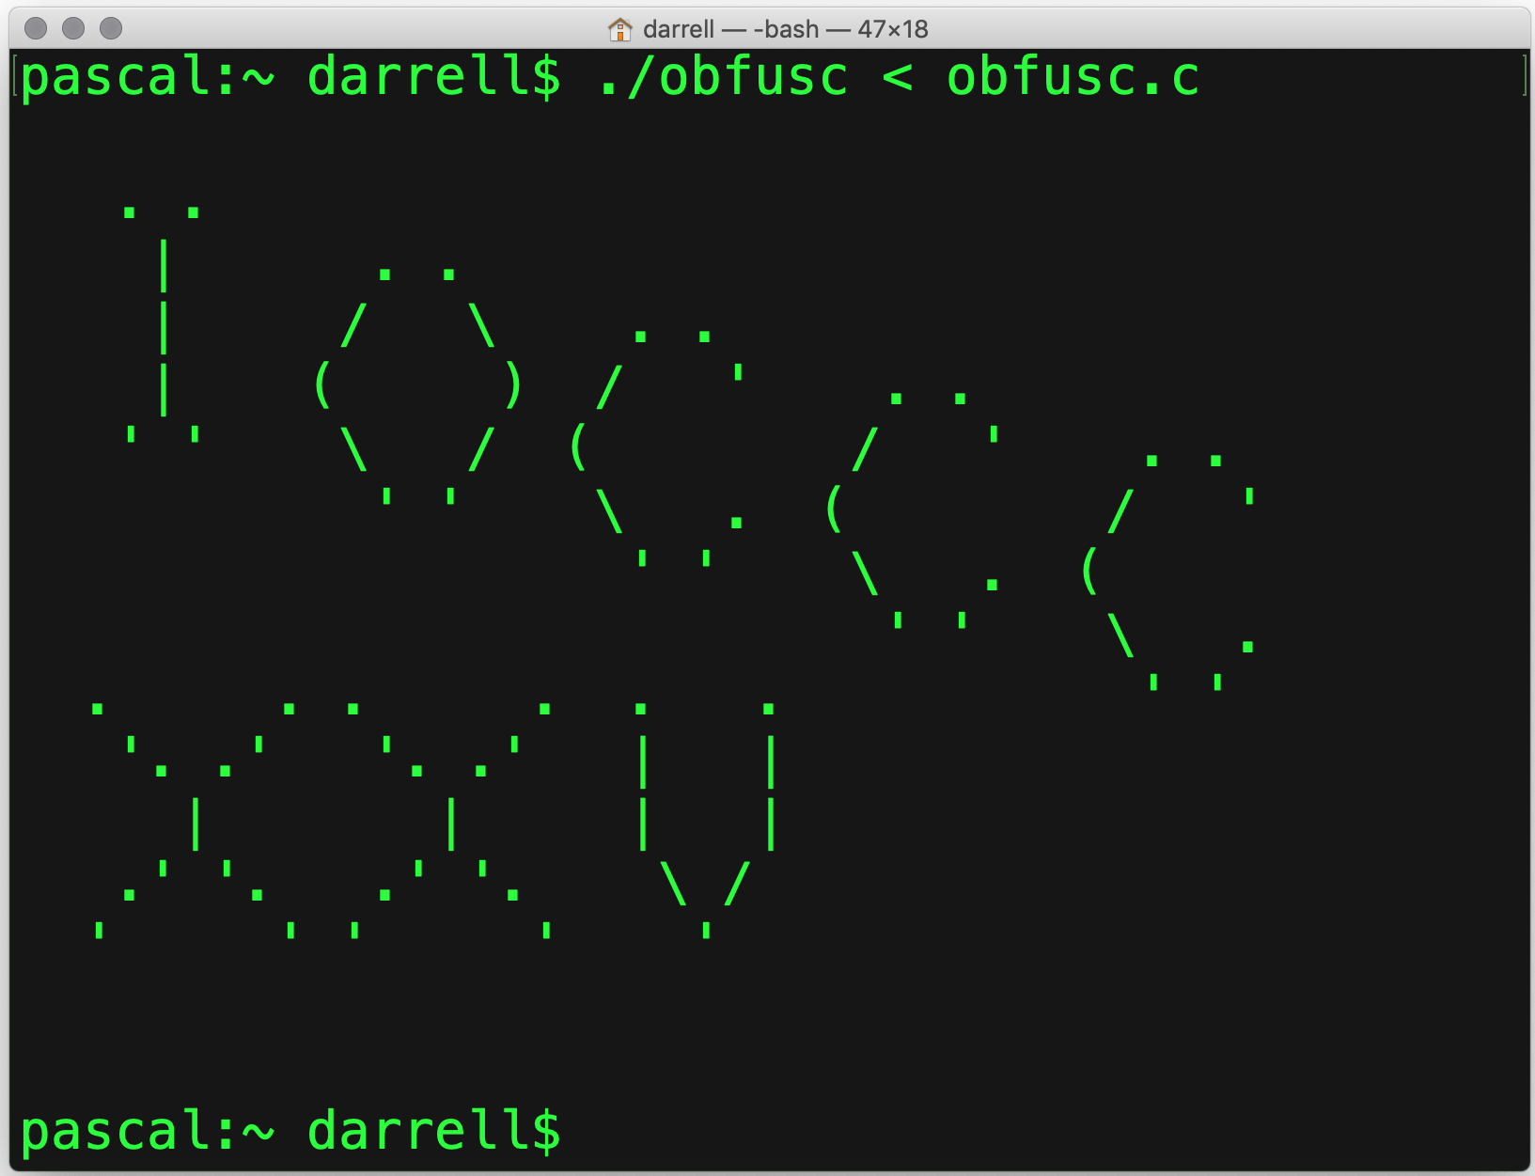
What does it do?

Slide 25
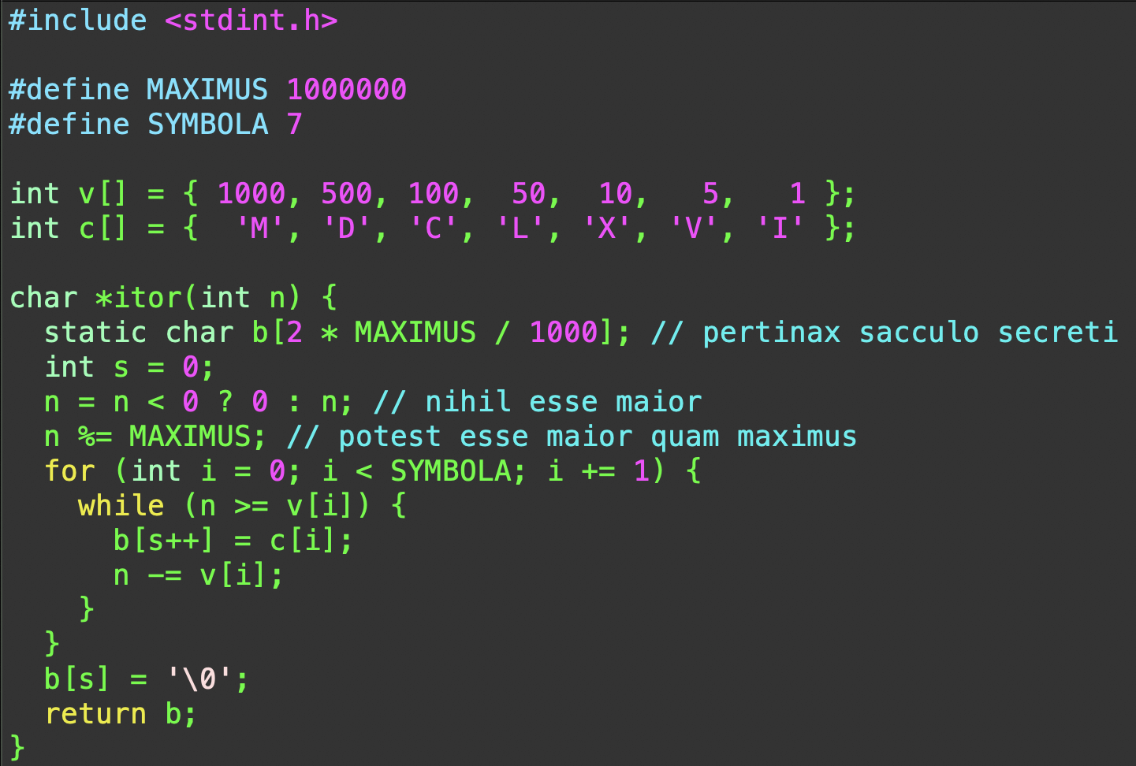
Vade Mecum
Walk with me through this code…
In it, you will see many of the things that you will learn this quarter.

Slide 26
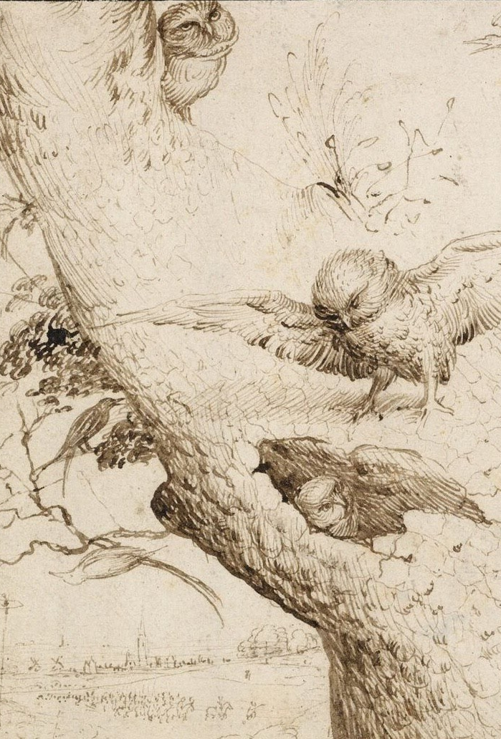
Summary
C provides the basic set of statements and operators that you expect from an imperative programming language.
It is relatively low level — close to the machine (in contrast to a language like Python).
You can write unreadable programs — Don’t try to be clever by being obscure.
Clarity is paramount!
C is powerful, but Programming in C can be dangerous!

